Slide 1
Working with Databases using Entity Framework Core

Slide 2
Objectives
Overview Entity Framework Core (EF Core)
Explain components inside Entity Framework Core
Explain about Database First Model and Code Model
Explain about Manipulating data with Entity Framework Core
Demo create accessing database by Entity Framework Core using Database First Model
Demo create accessing database by Entity Framework Core using Code Model
Demo using LINQ Queries in Entity Framework Core

Slide 3
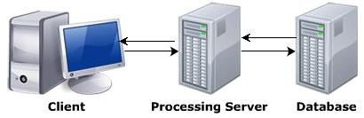
What is Database?
Database is a collection of related records
The information in DB is stored in such a way that it is easier to access, manage, and update the data
Data from the DB can be accessed using any one of the following architectures:
Single-tier architecture
Two-tier architecture
Three-tier architecture

Slide 4
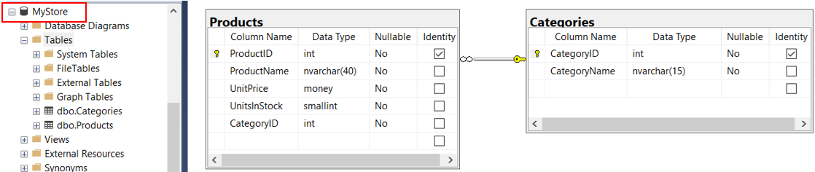
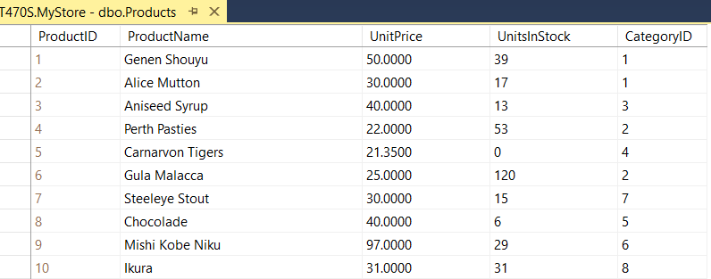
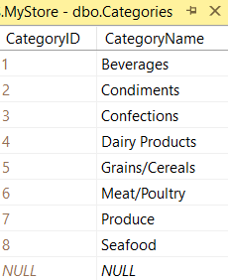
Database sample for Demonstration

Slide 5
Understanding Legacy Entity Framework
Entity Framework (EF) was first released as part of .NET Framework 3.5 with Service Pack 1 back in late 2008
Entity Framework has evolved, as Microsoft has observed how programmers use an object-relational mapping (ORM) tool in the real world
ORMs use a mapping definition to associate columns in tables to properties in classes and a programmer can interact with objects of different types in a way that they are familiar with, instead of having to deal with knowing how to store the values in a relational table or another structure provided by a NoSQL data store

Slide 6
Understanding Legacy Entity Framework
The version of EF included with .NET Framework is Entity Framework 6 (EF6). It is mature, stable, and supports an old EDMX (XML file) way of defining the model as well as complex inheritance models, and a few other advanced features
EF 6.3 and later have been extracted from .NET Framework as a separate package so it can be supported on .NET Core 3.0 and later, including .NET 5. This enables existing projects like web applications and services to be ported and run cross-platform
EF6 should be considered a legacy technology because it has some limitations when running cross-platform and no new features will be added to it

Slide 7
Understanding Entity Framework Core
Entity Framework Core (EF Core) is a lightweight, extensible, open source and cross-platform version of the popular Entity Framework data access technology
EF Core allows us to interact with data from relational databases using an object model that maps directly to the business objects (or domain objects) in our application
EF Core can serve as an object-relational mapper (O/RM), which:
Enables .NET developers to work with a database using .NET objects
Eliminates the need for most of the data-access code that typically needs to be written

Slide 8
Understanding Entity Framework Core
EF Core 5.0 runs on platforms that support .NET Standard 2.1, meaning .NET Core 3.0 and 3.1, as well as .NET 5. It will not run on.NET Standard 2.0 platforms like .NET Framework 4.8
Entity Framework Core supports many database providers to access different databases and perform database operations:
SQL Server (www.nuget.org/packages/Microsoft.EntityFrameworkCore.SqlServer)
MySQL (www.nuget.org/packages/MySQL.Data.EntityFrameworkCore)
PostgreSQL (www.nuget.org/packages/Npgsql.EntityFrameworkCore.PostgreSQL)
SQLite (www.nuget.org/packages/Microsoft.EntityFrameworkCore.Sqlite)
Oracle (www.nuget.org/packages/Oracle.ManagedDataAccess.Core)
In-memory (www.nuget.org/packages/Microsoft.EntityFrameworkCore.InMemory)
More database provider: https://docs.microsoft.com/en-us/ef/core/providers/

Slide 9
Understanding Entity Framework Core
To manage data in a specific database, we need classes that know how to efficiently talk to that database
EF Core database providers are sets of classes that are optimized for a specific data store. There is even a provider for storing the data in the memory of the current process, which is useful for high performance unit testing since it avoids hiing an external system

Slide 10
Understanding Entity Framework Core
The distributed NuGet packages as shown in the following table:
Database | NuGet Package Name
Microsoft SQL Server 2012 or later | Microsoft.EntityFrameworkCore.SqlServer
SQLite 3.7 or later | Microsoft.EntityFrameworkCore.SQLite
MySQL | MySQL.Data.EntityFrameworkCore
In-memory | Microsoft.EntityFrameworkCore.InMemory
Azure Cosmos DB SQL API | Microsoft.EntityFrameworkCore.Cosmos
Oracle DB 11.2 | Oracle.EntityFrameworkCore

Slide 11
What Is an Object-Relational (OR) Mapper?
In the database world, relational databases are prevalent and the programming world is all about objects
Working with objects as instances of classes in memory is at the core of objectoriented programming (OOP)
Most applications also include the requirement to permanently store data in objects, especially in databases. Basically, there are object oriented databases (OODBs) that are directly able to store objects, but OODBs have only a small distribution so far. Relational databases are more predominant, but they map the data structures differently than object models

Slide 12
What is an Object-Relational (OR) Mapper?
To make the handling of relational databases more natural in object-oriented systems, the software industry has been relying on object-relational mappers
The tools translate concepts from the object-oriented world, such as classes, attributes, or relationships between classes, to corresponding constructs of the relational world, such as tables, columns, and foreign keys
Developers can thus remain in the object-oriented world and instruct the OR mapper to load or store certain objects that are in the form of records in tables of the relational database

Slide 13
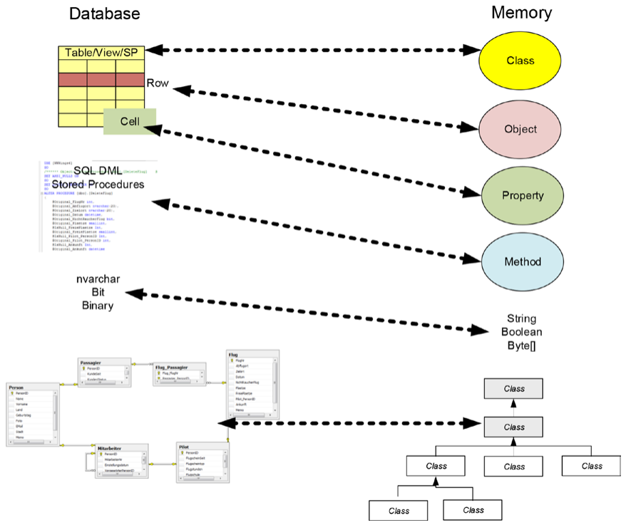
The OR mapper translates constructs of the OOP world to the relational world

Slide 14
New Features in Entity Framework Core
Entity Framework Core runs not only on Windows, Linux, and macOS but also on mobile devices running Windows 10, iOS, and Android. On mobile devices, of course only access to local databases (such as SQLite) is provided
Entity Framework Core provides faster execution speeds, especially when reading data (almost the same performance as manually copying data from a DataReader object to a typed .NET object)
Batching allows the Entity Framework Core to merge INSERT, DELETE, and UPDATE operations into one database management system round-trip rather than sending each command one at a time

Slide 15
New Features in Entity Framework Core
Projections with Select() can now be mapped directly to entity classes. The detour via anonymous .NET objects is no longer necessary
Default values for columns in the database are now supported in both reverse engineering and forward engineering
In addition to the classic auto-increment values, newer methods such as sequences are now also allowed for key generation
The term shadow properties in Entity Framework Core refers to the now possible access to columns of the database table for which there are no attributes in the class

Slide 16
Process Models for Entity Framework Core
Entity Framework Core supports the following:
Reverse engineering of existing databases (an object model is created from an existing database schema)
Forward engineering of databases (a database schema is generated from an object model)
Reverse engineering (often referred to as database first) is useful if we already have a database or if developers choose to create a database in a traditional way
The second option, called forward engineering, gives the developer the ability to design an object model. From this, the developer can then generate a database schema

Slide 17
Process Models for Entity Framework Core
For the developer, forward engineering is usually better because we can design an object model that we need for programming
Forward engineering can be used at development time (via so-called schema migrations) or at runtime
A schema migration is the creation of the database with an initial schema or a later extension/modification of the schema

Slide 18
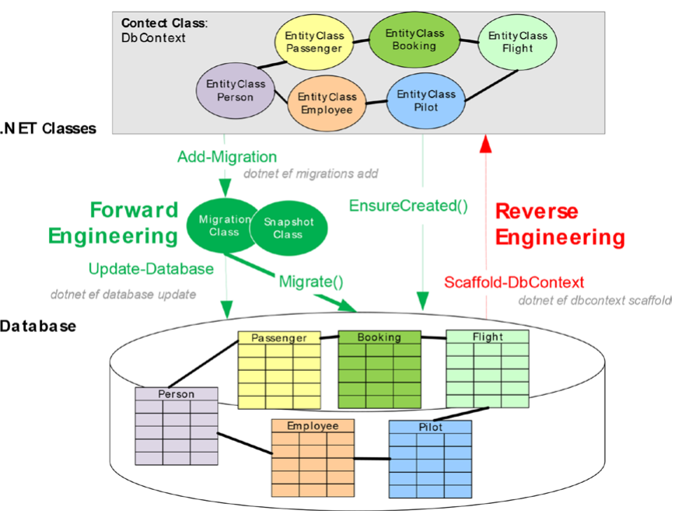
Forward engineering versus reverse engineering for Entity Framework Core

Slide 19
Components of Entity Framework Core
Entity classes (domain object classes, business object classes, data classes, or persistent classes) are representations of tables and views. They contain properties or fields that are mapped to columns of the tables/views
Entity classes can be plain old CLR objects (POCO classes); in other words, they need no base class and no interface
A context class is a class always derived from the DbContext base class. It has properties of type DbSet for each of the entity classes
The context class or DbSet properties take the commands of the self-created program code in the form of LINQ commands, SQL commands, stored procedure and table-valued function (TVF) calls, or special API calls for append, modify, and delete

Slide 20
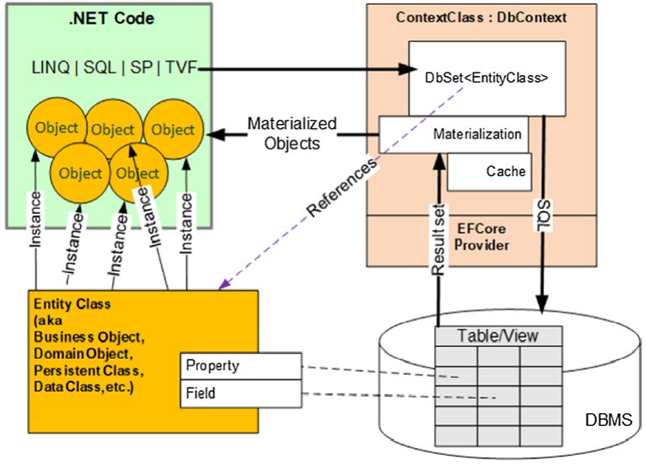
Components of Entity Framework Core
The context class sends the commands to the DBMS-specific provider, which sends the commands to the database via DbCommand objects and receives result sets in a DataReader from the database
The context class transforms the contents of the DataReader object into instances of the entity class. This process is called materialization
The central artifacts in Entity Framework Core and their context

Slide 21
DbContext Class
The DbContext doesn’t get used directly, but through classes that inherit from the DbContext class
The entities that are mapped to the database are added as DbSet<T> properties on the derived class
The OnModelCreating method is used to further define the mappings between the entities and the database
The following table shows some of the more commonly used members of the DbContext:

Slide 22
Member of DbContext | Description
Database | Provides access to database-related information and functionality, including execution of SQL statements
Model | The metadata about the shape of entities, the relationships between them, and how they map to the database. Note: This property is usually not interacted with directly
ChangeTracker | Provides access to information and operations for entity instances this context is tracking
DbSet<T> | Used to query and save instances of application entities. LINQ queries against DbSet properties are translated into SQL queries
EntryEntry<TEntity> | Provides access to change tracking information and operations (such as changing the EntityState) for the entity. Can also be called on an untracked entity to change the state to tracked
SaveChanges/SaveChangesAsync | Saves all entity changes to the database and returns the number of records affected
OnConfiguring | A builder used to create or modify options for the context. Executes each time a DbContext instance is created. Note: It is recommended not to use this, and instead use the DbContextOptions to configure the context at runtime, and use an instance of the IDesignTimeDbContextFactory at design time
OnModelCreating | Called when a model has been initialized, but before it’s finalized. Methods from the Fluent API are placed in this method to finalize the shape of the model

Slide 23
DbSet Class
For each entity in our object model, we add a property of type DbSet<T>. The DbSet<T> is a specialized collection property used to interact with the database provider to get, add, update, or delete records in the database
Each DbSet<T> provides a number of core services to each collection, such as creating, deleting, and finding records in the represented table
The following table describes some of the core members of the DbSet<T> class:

Slide 24
The following table describes some of the core members of the DbSet<T> class:
Member of DbSet<T> | Description
Add/AddRange | Begins tracking the entity/entities in the Added state. Item(s) will be added when SaveChanges is called. Async versions are available as well
Find | Searches for the entity in the ChangeTracker by primary key. If not found, the data store is queried for the object. An async version is available as well
Update/UpdateRange | Begins tracking the entity/entities in the Modified state. Item(s) will be updated when SaveChanges is called. Async versions are available as well
Remove/RemoveRange | Begins tracking the entity/entities in the Deleted state. Item(s) will be removed when SaveChanges is called. Async versions are available as well
Attach/AttachRange | Begins tracking the entity/entities in the Unchanged state. No operation will execute when SaveChanges is called. Async versions are available as well

Slide 25
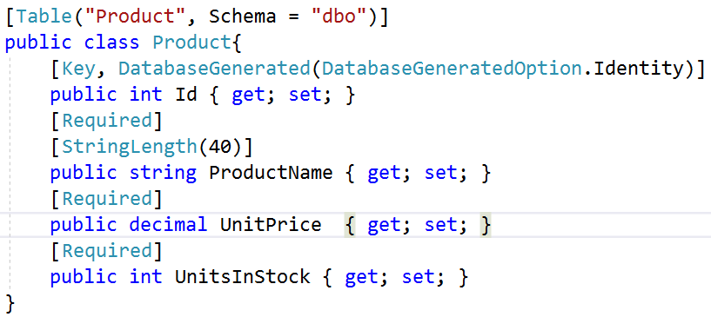
Entities
Entities are a conceptual model of a physical database that maps to our business domain. This model is termed an entity data model (EDM). The EDM is a client-side set of classes that are mapped to a physical database by Entity Framework Core convention and configuration

Slide 26
Defining Entity Framework Core Models
An entity class represents the structure of a table and an instance of the class represents a row in that table
EF Core uses a combination of Conventions, Annotation Atributes, and Fluent API statements to build an entity model at runtime so that any actions performed on the classes can later be automatically translated into actions performed on the actual database

Slide 27
Defining Entity Framework Core Models
EF Core Conventions: The code we will write will use the following conventions:
The name of a table is assumed to match the name of a DbSet<T> property in the DbContext class, for example, Products
The names of the columns are assumed to match the names of properties in the class, for example, ProductID
The string .NET type is assumed to be a nvarchar type in the database
The int .NET type is assumed to be an int type in the database
A property that is named ID , or if the class is named Product, then the property can be named ProductID

Slide 28
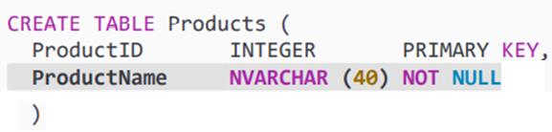

Defining Entity Framework Core Models
EF Core Annotation attributes: Conventions often aren't enough to completely map the classes to the database objects. Another way of adding more smarts to our model is to apply annotation attributes
For example, in the database, the maximum length of a ProductName is 40 , and the value cannot be null. In a Product class, we could apply aributes to specify this, as shown in the following code:

Slide 29
Data Annotations Supported by the Entity Framework
Data Annotation | Description
Table | Defines the schema and table name for the entity
Column | Defines the column name for the model property
Key | Defines the primary key for the model. Key fields are implicitly also [Required]
Required | Declares the property as not nullable in the database
ForeignKey | Declares a property that is used as the foreign key for a navigation property
InverseProperty | Declares the navigation property on the other end of a relationship
StringLength | Specifies the max length for a string property
TimeStamp | Declares a type as a rowversion in SQL Server and adds concurrency checks to database operations involving the entity
ConcurrencyCheck | Flags field to be used in concurrency checking when executing updates and deletes
DatabaseGenerated | Specifies if the field is database generated or not. Takes a DatabaseGeneratedOption value of Computed, Identity, or None
DataType | Provides for a more specific definition of a field than the intrinsic datatype
NotMapped | Excludes the property or class in regard to database fields and tables

Slide 30
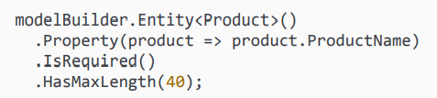
Defining Entity Framework Core Models
EF Core Fluent API: The Fluent API configures the application entities through C# code. The methods are exposed by the ModelBuilder instance available in the DbContext, OnModelCreating method
The Fluent API is the most powerful of the configuration methods and overrides any data annotations or conventions that are in conflict. Some of the configuration options are only available using the Fluent API, such as complex keys and indices
For example, the maximum length of a ProductName is 40 , and the value cannot be null, we could apply Fluent API Fluent API statement in the OnModelCreating method of a database context class, as shown in the following code:

Slide 31
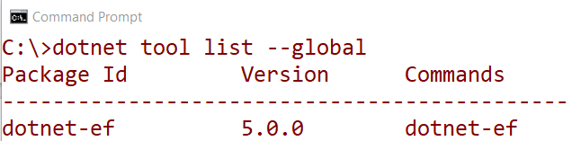
The EF Core Global Tool CLI Commands
The dotnet-ef global CLI tool EF Core tooling contains the commands needed to scaffold existing databases into code, to create/remove migrations (changes in the data structure based on the entities), and to operate on a database (update, drop, etc.)
Open Command Prompt (or Terminal) then run as the following command:
Check if we have already installed dotnet-ef as a global tool

Slide 32
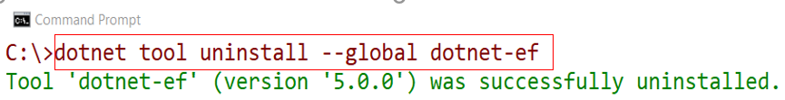
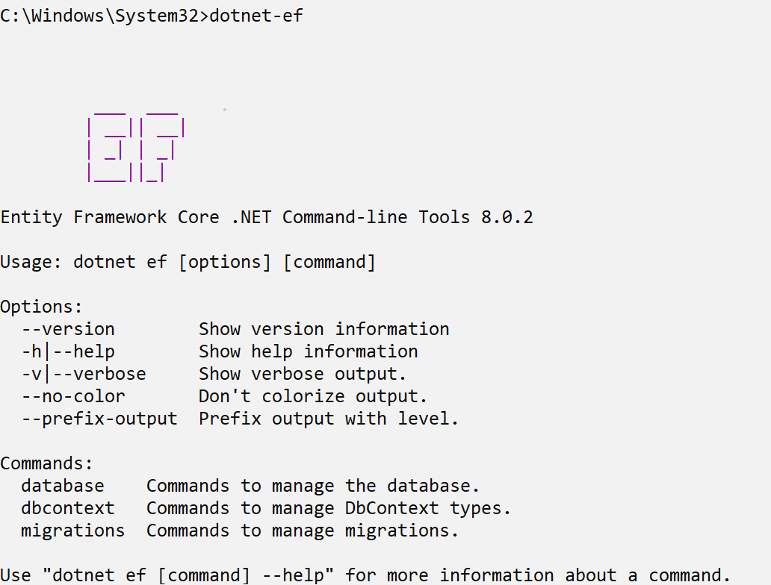
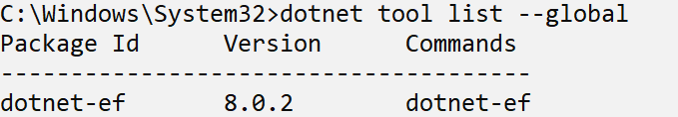
The EF Core Global Tool CLI Commands
If an old version is already installed, then uninstall the tool, as shown in the following command:
Install the latest version, as shown in the following command:
dotnet tool install --global dotnet-ef --version 8.0.2

Slide 33
The EF Core Global Tool CLI Commands
The three main commands in the EF Core global tool are shown in the following table:
Command | Description
Database | Commands to manage the database. Sub-commands include drop and update
DbContext | Commands to manage the DbContext types. Sub-commands include scaffold, list, and info
Migrations | Commands to manage migrations. Sub-commands include add, list, remove, and script
Each main command has additional sub-commands. As with the all of the .NET Core commands, each command has a rich help system that can be accessed by entering -h along with the command

Slide 34
Reverse Engineering of Existing Databases Demonstration

Slide 35
Create a sample database named MyStore for demonstrations

Slide 36
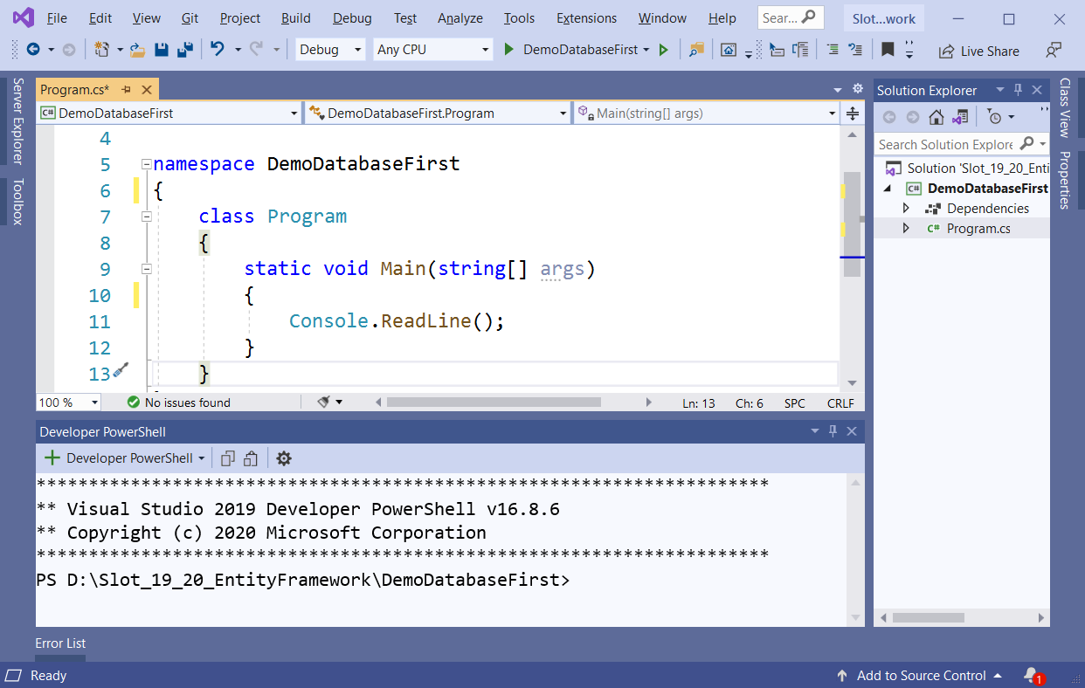
1.Create a Console App named DemoDatabaseFirst then right-click on project , select Open In Terminal to install packages

Slide 37
2.On Developer PowerShell dialog , execute the following commands to install packages:
dotnet add package Microsoft.EntityFrameworkCore.design
dotnet add package Microsoft.EntityFrameworkCore.SqlServer
3.On Developer PowerShell dialog , execute the following commands to generate model:
dotnet ef dbcontext scaffold "server =(local); database = MyStore;uid=sa;pwd=123;" Microsoft.EntityFrameworkCore.SqlServer --output-dir Models

Slide 38
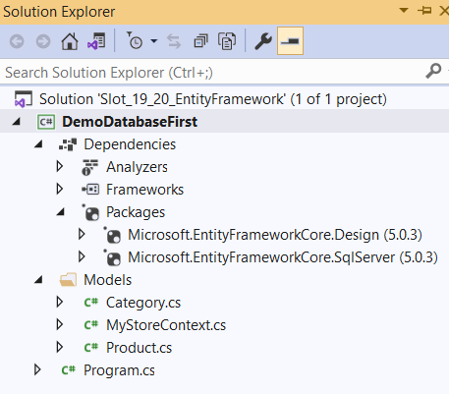
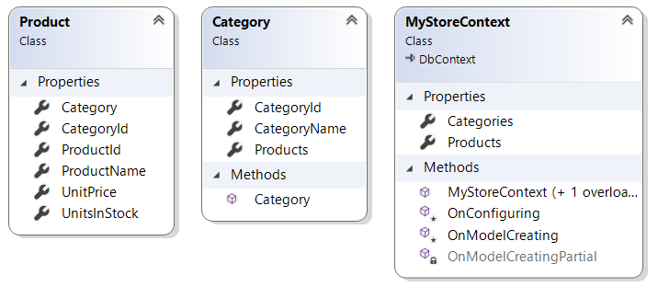
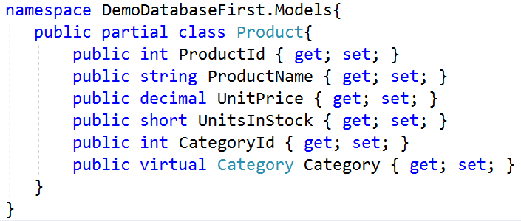
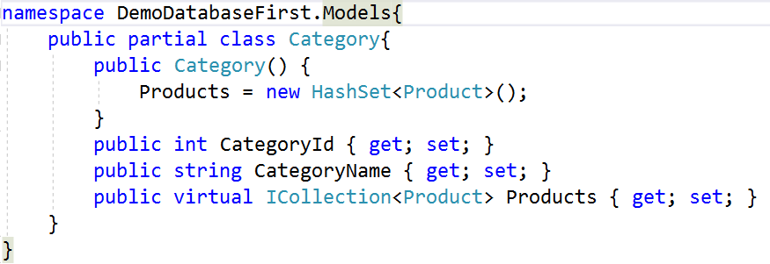

Slide 39
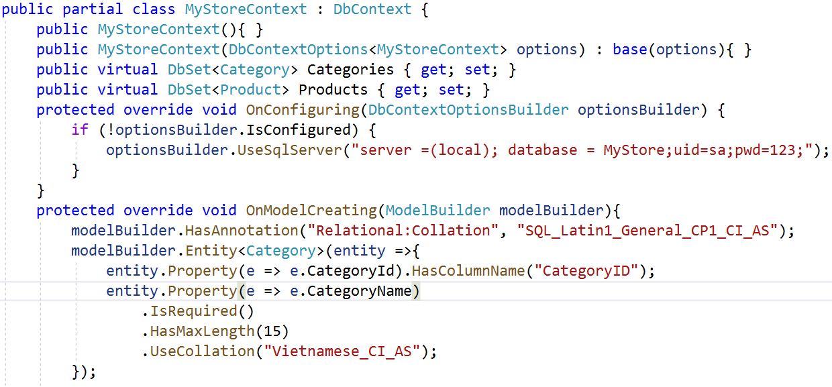
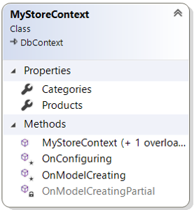
MyStoreConext Class

Slide 40
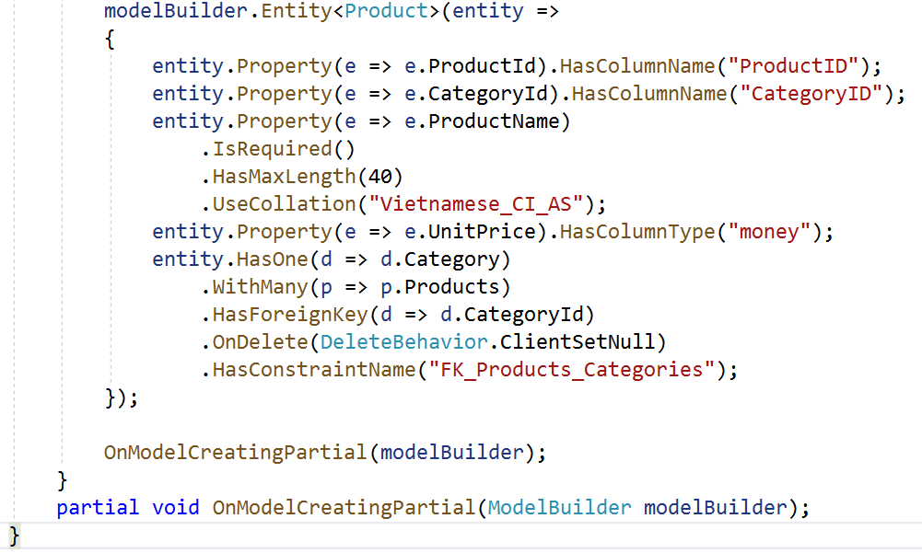

Slide 41
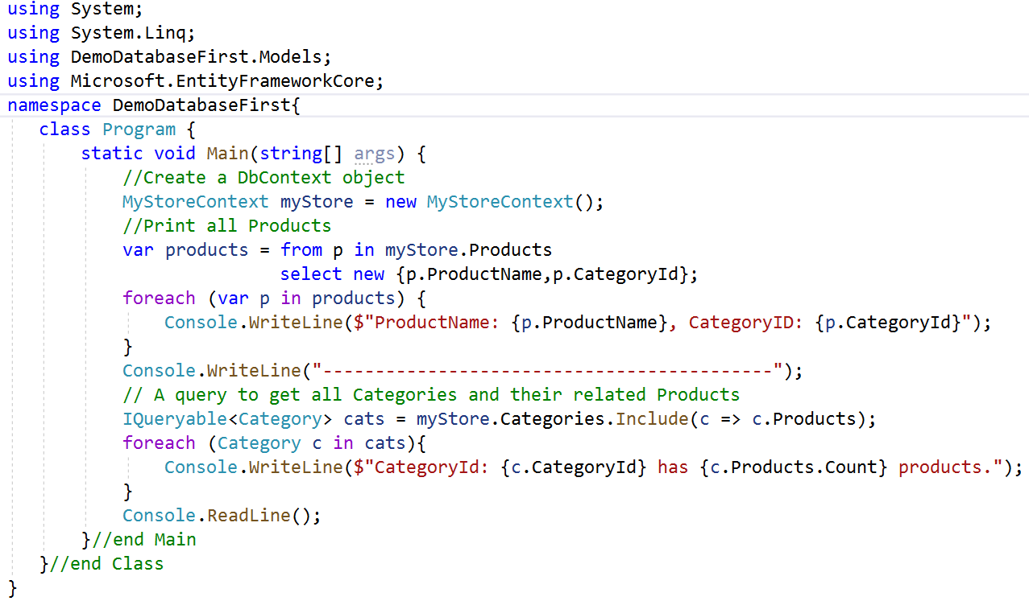
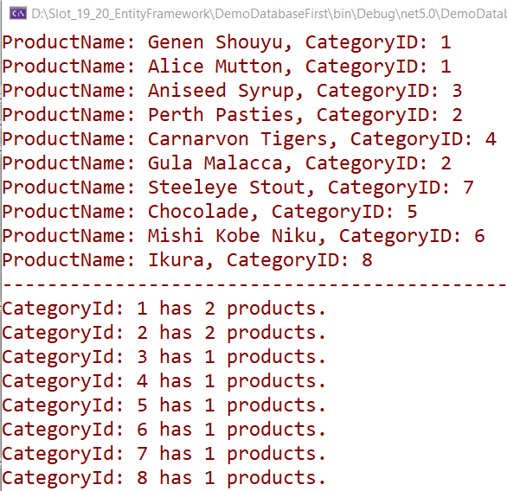
4.Write codes for Program.cs then run project

Slide 42
The Weaknesses Reverse Engineering
In the case of the temporal tables (called system-versioned tables) added in SQL Server , the history tables cannot be mapped using Entity Framework Core (this is already possible for the actual table)
For database views and stored procedures, in contrast to the classic Entity Framework, classes and functions cannot be generated
Once the object model is generated using the Entity Framework Core commandline tools, we cannot update it
The Update Model from Database command available for the Database First approach is currently not implemented

Slide 43
Forward Engineering for New Databases
Forward engineering is available in the classic Entity Framework in two variants: Model First and Code First
In Model First, we graphically create an entity data model (EDM) to generate the database schema and .NET classes
In Code First, we write classes directly, from which the database schema is created
The EDM is invisible. In the redesigned Entity Framework Core, there is only the second approach, which however is not called Code First but code-based modeling and no longer uses an invisible EDM

Slide 44
Forward Engineering for New Databases
Code-based modeling in Entity Framework Core happens through these two types of classes:
We create entity classes, which store the data in RAM. We create navigation properties in the entity classes that represent the relationships between the entity classes. These are typically plain old CRL objects (POCOs) with properties for each database column
We write a context class (derived from DbContext) that represents the database model, with each of the entities listed as a DBSet. This will be used for all queries and other operations

Slide 45
Forward Engineering for New Databases Demonstration

Slide 46
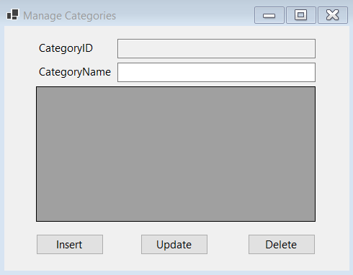
1.Create a Winform app named ManageCategoriesApp includes a form named frmManageCategories and has controls as follows :
Object Type | Object name | Properties / Events
Label | lbCategoryID | Text: lbCategoryID
Label | lbCategoryName | Text: CategoryName
TextBox | txtCategoryID | ReadOnly: True
TextBox | txtCategoryName
Button | btnInsert | Text: Insert Event Handler: Click
Button | btnUpdate | Text: Update Event Handler: Click
Button | btnDelete | Text: Delete Event Handler: Click
DataGridView | dgvCategories | ReadOnly: True SelectionMode:FullRowSelect
Form | frmManageCategories | StartPosition: CenterScreen Text: Manage Categories Event Handler: Load

Slide 47
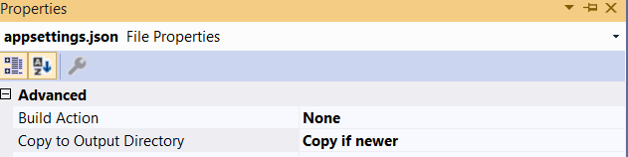
2.Right-click on the project | Add | New Item, select JavaScript JSON Configuration File then rename to appsettings.json , click Add and write contents as follows:
{
"ConnectionStrings": {
"MyStockDB": "Server=(local);uid=sa;pwd=123;database=MyStockDB"
}
}
Next , right-click on appsettings.json | Properties, select Copy if newer

Slide 48
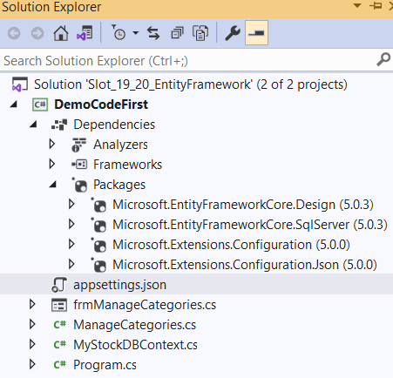
3.Install the following packages from Nuget
4.Add to the project 02 classes: ManageCategories.cs and MyStockDBContext.cs

Slide 49
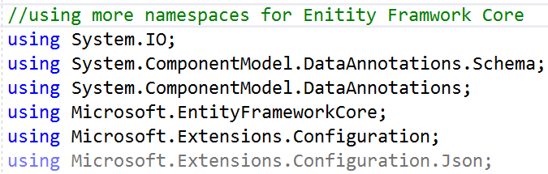
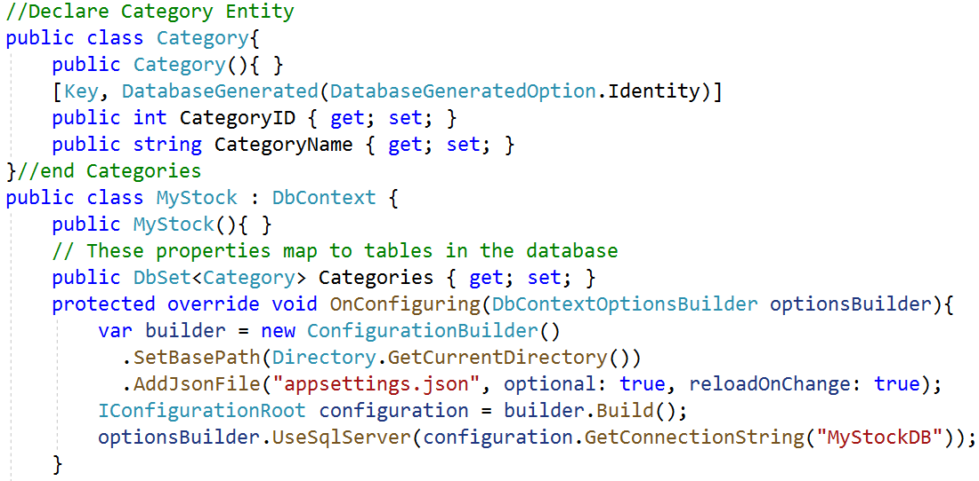
5.Write codes MyStockDBContext.cs as follows:

Slide 50
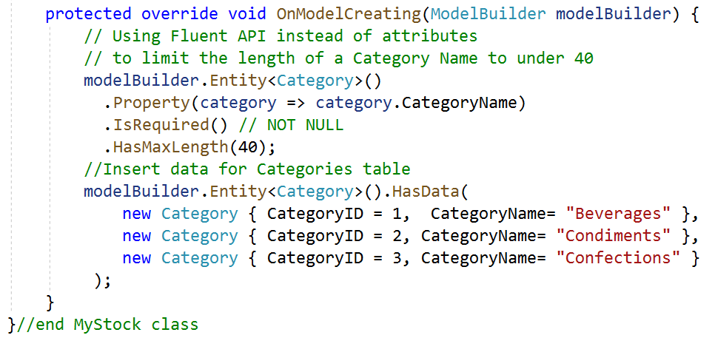
6.Right-click on the project, select Open in Terminal. On Developer PowerShell dialog , execute the following commands to generate database:
dotnet ef migrations add "Initial"
dotnet ef database update

Slide 51
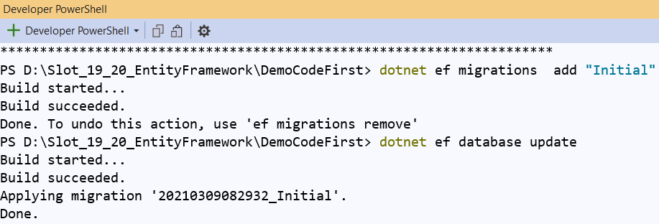
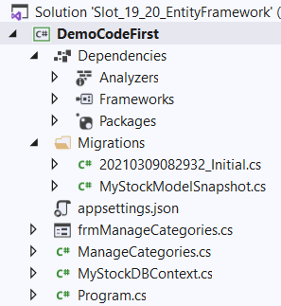
6. Write codes ManageCategories.cs as follows:

Slide 52
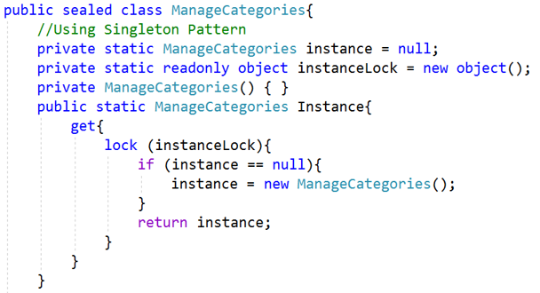
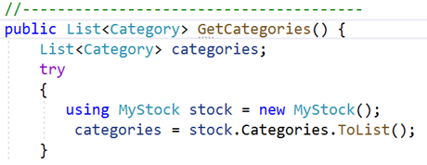
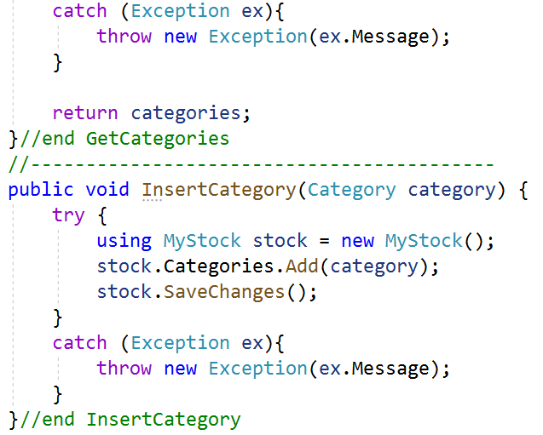

Slide 53
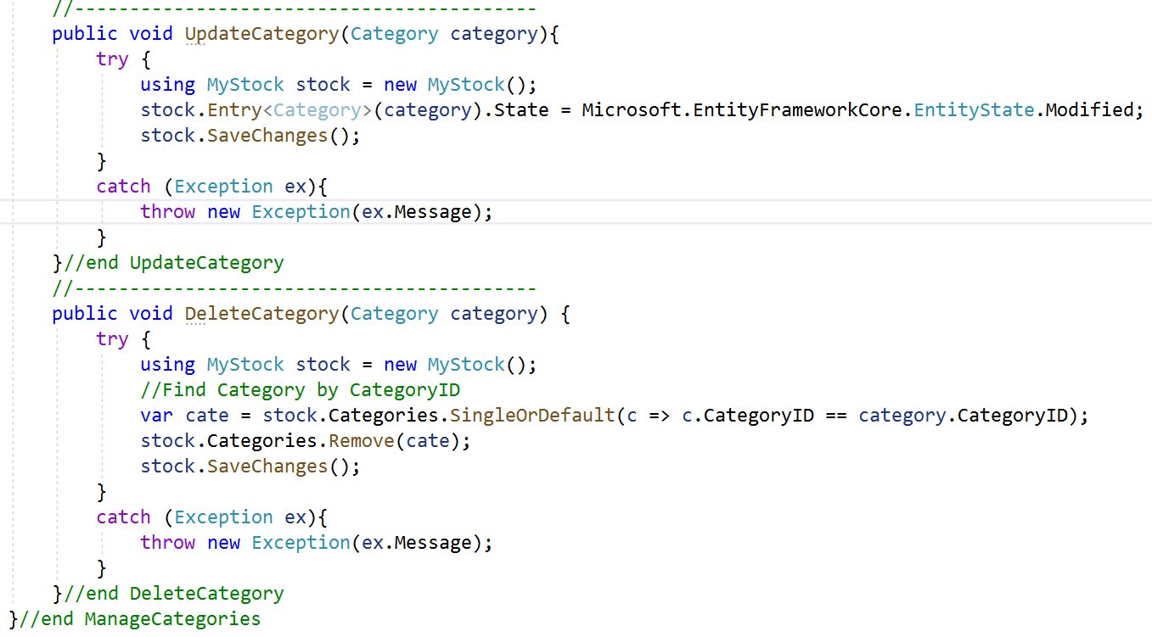

Slide 54
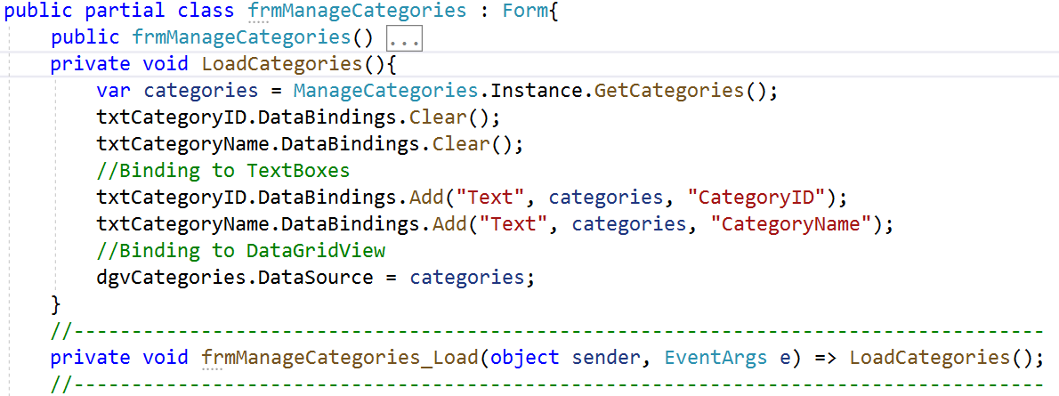
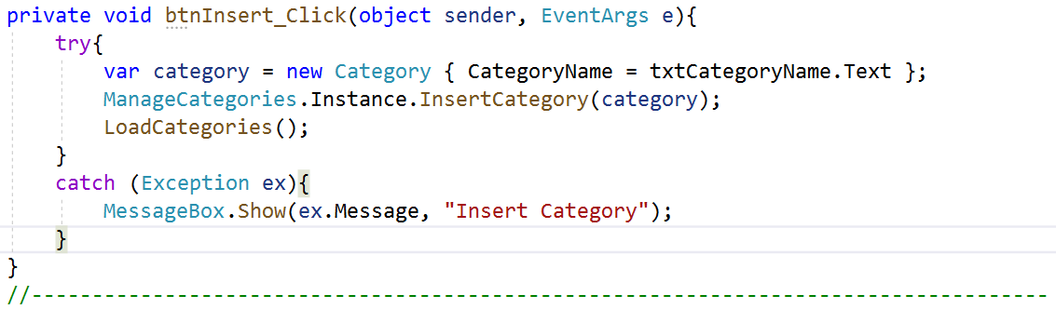
8.Write codes in frmManageCategories.cs as follows then press Ctrl+F5 to run project:

Slide 55
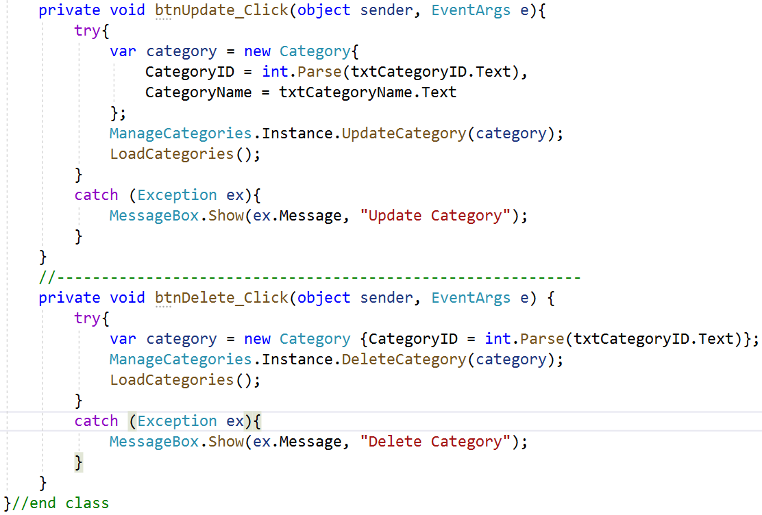
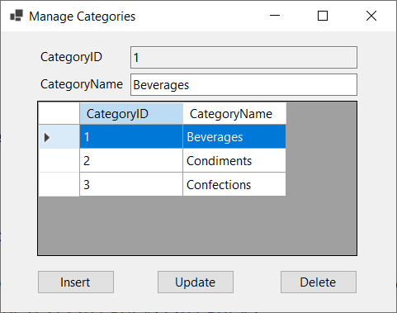

Slide 56
Querying EF Core Models
Entity Framework Core allows us to write database queries with Language Integrated Query (LINQ)
The starting point for all LINQ queries in Entity Framework Core is the context class that we create either during the reverse engineering of an existing database or manually while forward engineering
The context class in Entity Framework Core always inherits from the base class Microsoft.EntityFrameworkCore.DbContext. Accordingly, we have to use DbContext for all LINQ operations
The DbContext class implements the IDisposable interface. As part of the Dispose() method, DbContext frees all allocated resources, including references to all objects loaded with change tracking

Slide 57
LINQ Queries
After instantiating the context class, we can formulate a LINQ query. This query is not necessarily executed immediately; it is initially in the form of an object with the interface IQueryable<T>
The LINQ query is executed when the result is actually used (for example, in a foreach loop) or when converted to another collection type
We can force the execution of the query with a LINQ conversion operator with ToList(), ToArray(), ToLookup(), ToDictionary(), Single(), SingleOrDefault(), First(), FirstOrDefault(), or an aggregate operator such as Count(), Min(), Max(), or Sum()

Slide 58
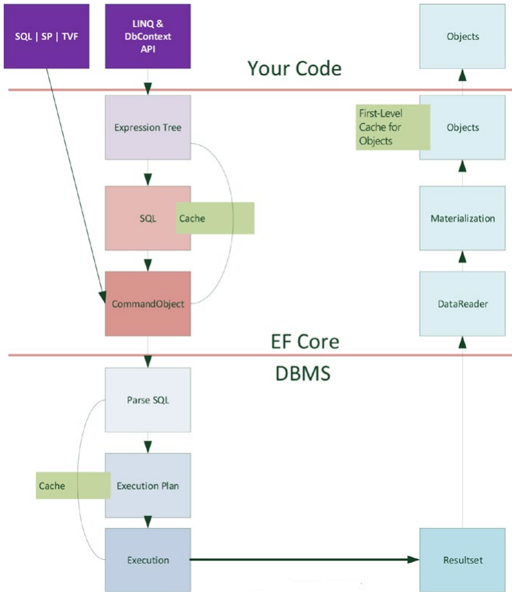
Internals for running a LINQ command through Entity Framework Core

Slide 59
LINQ Queries Demonstrations
(using Reverse Engineering of Existing Databases Demo)

Slide 60
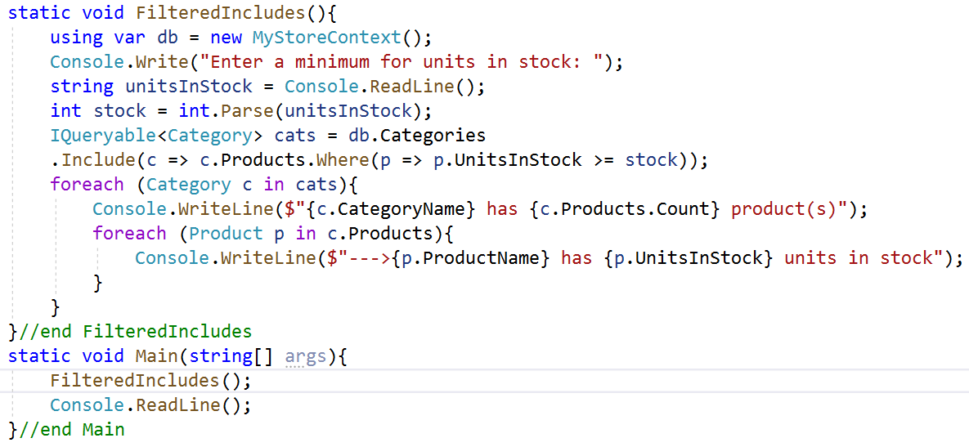
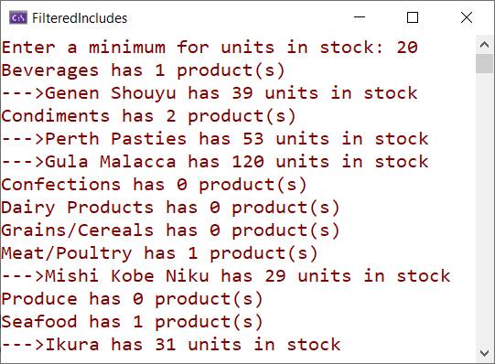
Create a query for categories that have products with that minimum number of units in stock. Enumerate through the categories and products, outpuing the name and units in stock for each one (using Reverse Engineering of Existing Databases Demonstration)

Slide 61
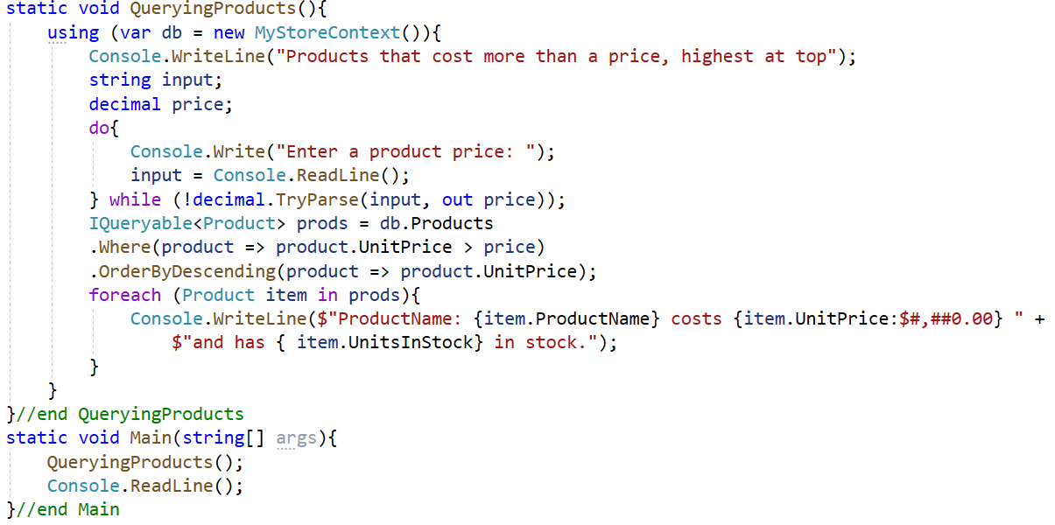
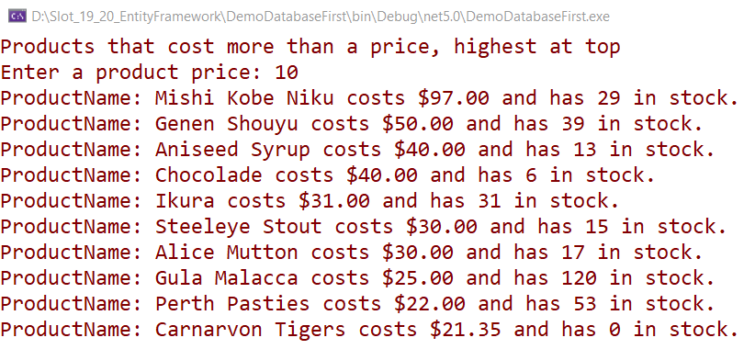
Create a query for products that cost more than the price

Slide 62
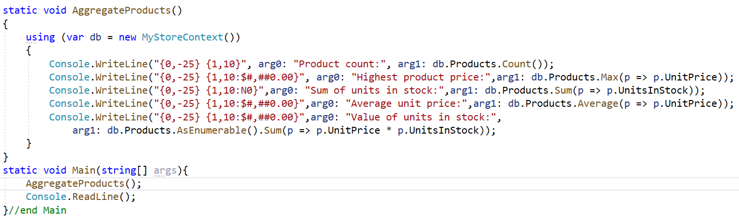
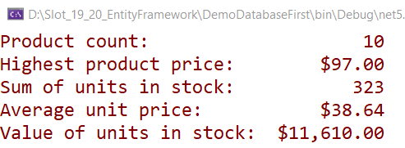
Perform aggregation functions, such as Average and Sum on the Products table

Slide 63
Lab and Assigment
1. Do Hands-on Lab: Lab_02_AutomobileManagement_Using_EF Core and WPF.pdf 2. Do Assigment: Assignment_02_HotelManagement.pdf

Slide 64
Summary
Concepts were introduced:
Overview Entity Framework Core(EF Core)
Explain components inside Entity Framework Core
Explain about Database First Model and Code Model
Explain about Manipulating data with EF Core
Demo create accessing database by Entity Framework Core using Database First Model
Demo create accessing database by Entity Framework Core using Code Model
Demo using LINQ Queries in Entity Framework Core

